Slide 1
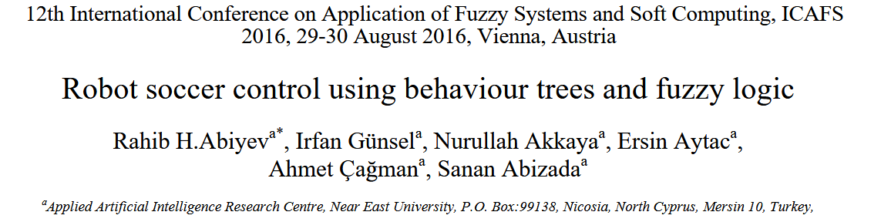
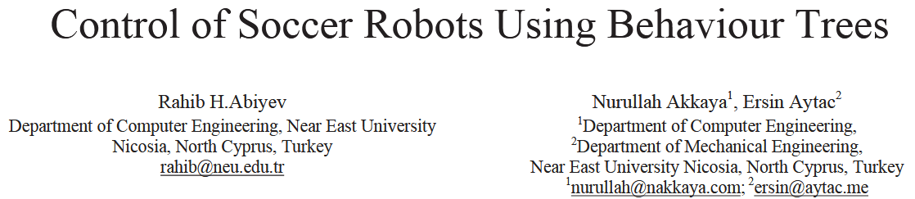
Notes:
2016年第十二届模糊系统与软计算应用国际会议
2013年第九届亚洲控制大会(Asian Control Conference ASCC)

Slide 2

Background
6 vs 6
RoboCup competition – small size

Slide 3
Background
fast changing areas + moving dynamic obstacles
short time, flexibility and on-line adaptation strategies
FSM /Petri nets /behavior-based control /topological graph map
Notes:
有限状态自动机、

Slide 4
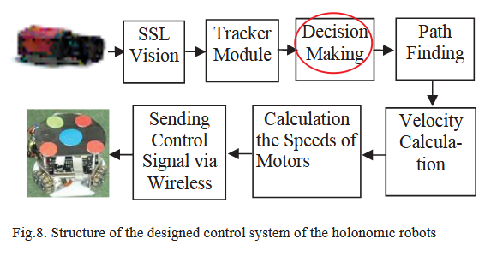
Control structure
fuzzy logic
BT +
fuzzy logic

Slide 5
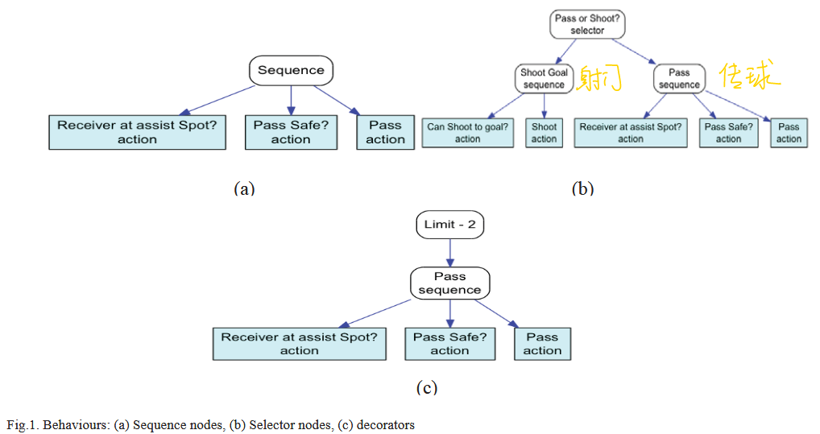
Decision Making
Notes:
Node、sequence、selector、decorator

Slide 6
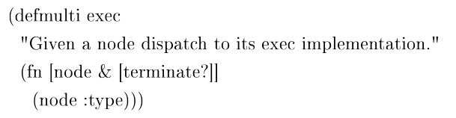
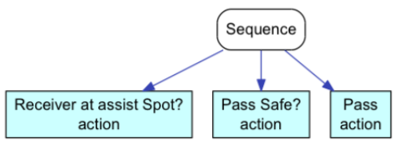
Node

Slide 7
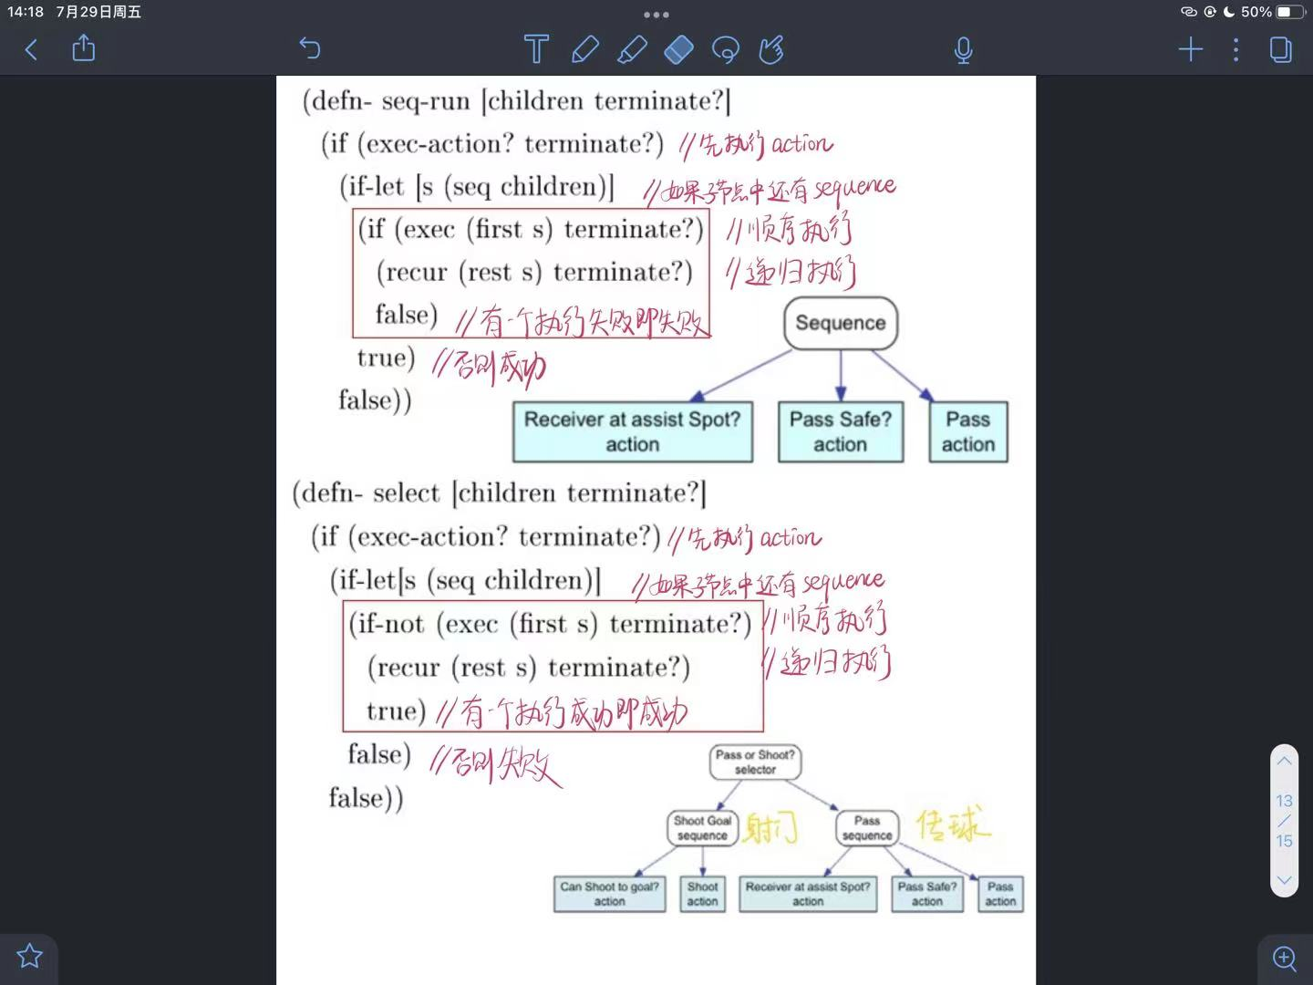
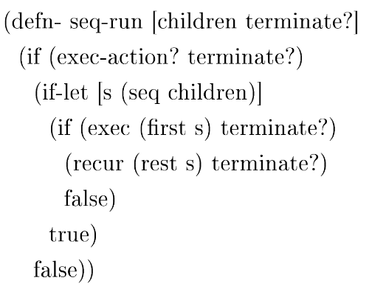
Sequence

Slide 8
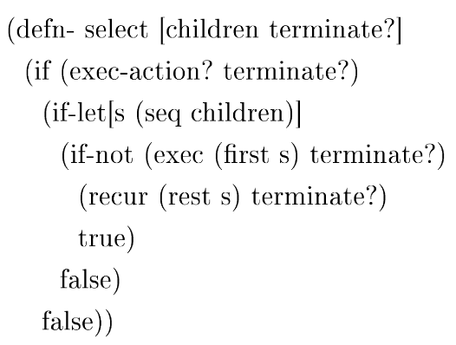
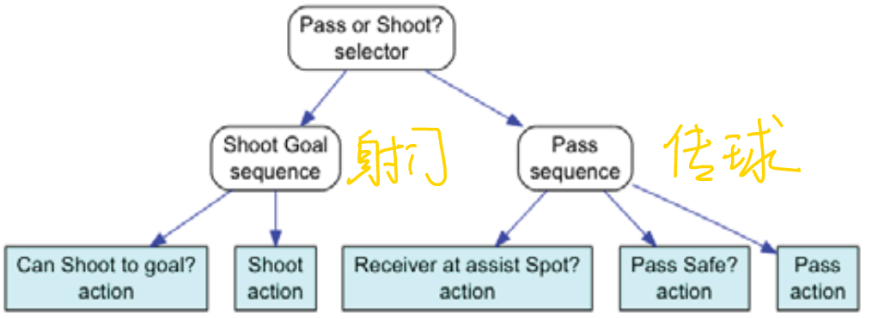
Selector

Slide 9
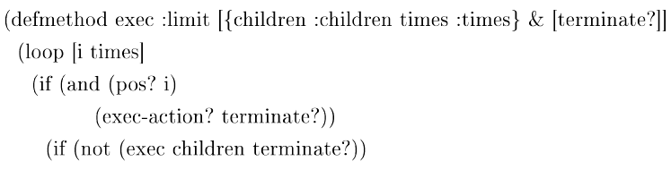
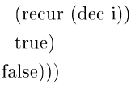
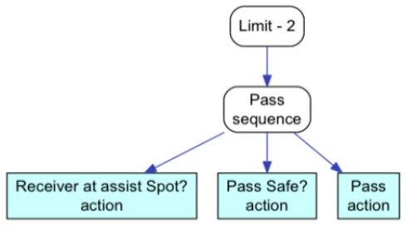
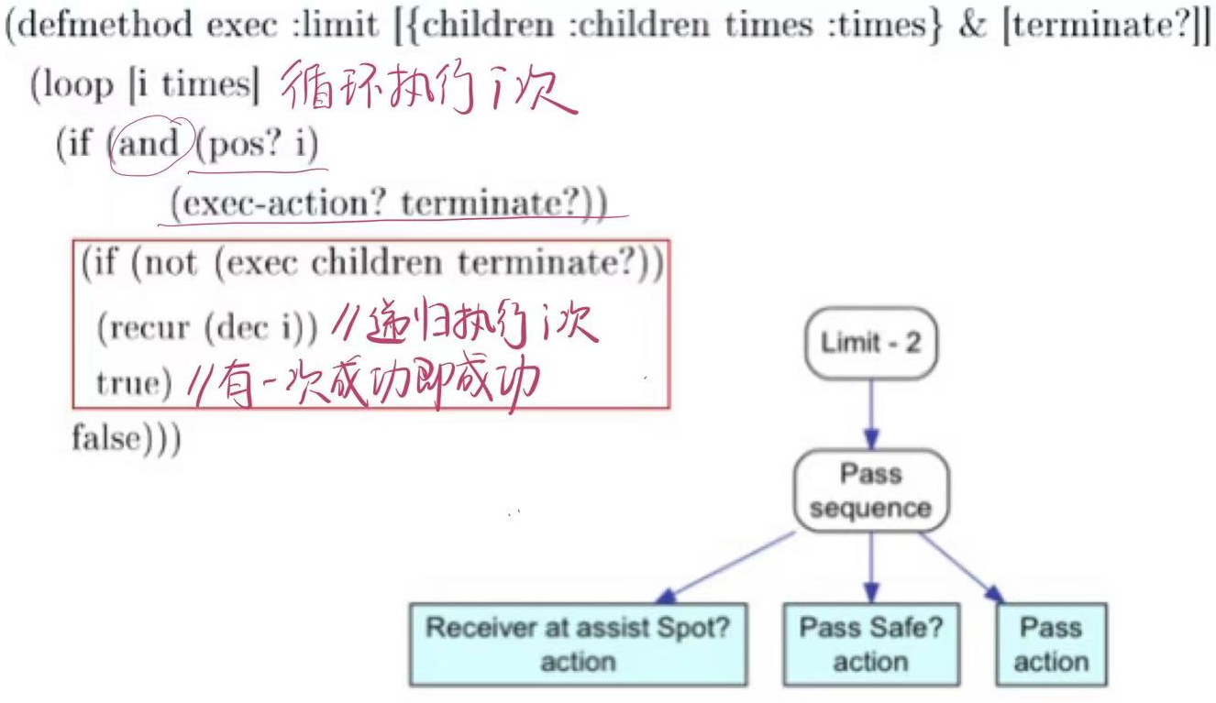
Decorator

Slide 10
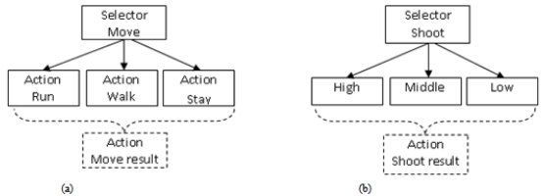
Fuzzy Selector
continues value

Slide 11
Fuzzy Selector
Rule Base:
If ball is near and ball speed is low then execute sequence walk
If ball is far away and ball speed is high then execute sequence run
If ball is far away and ball speed is very low then execute sequence stay

Slide 12
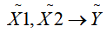
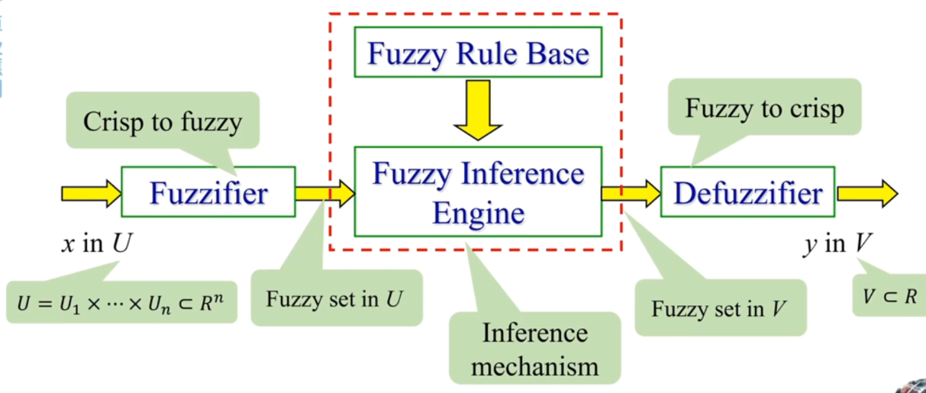
Fuzzy Selector
Rule Base:
If ball is near and ball speed is low then execute sequence walk
If ball is far away and ball speed is high then execute sequence run
If ball is far away and ball speed is very low then execute sequence stay
distance to the ball + speed of the ball → speed of the robot
Notes:
把X1,X2模糊化，得到隶属度，
除了加权平均判决法，还有最大值均值法、中心法、最大值平均法

Slide 13
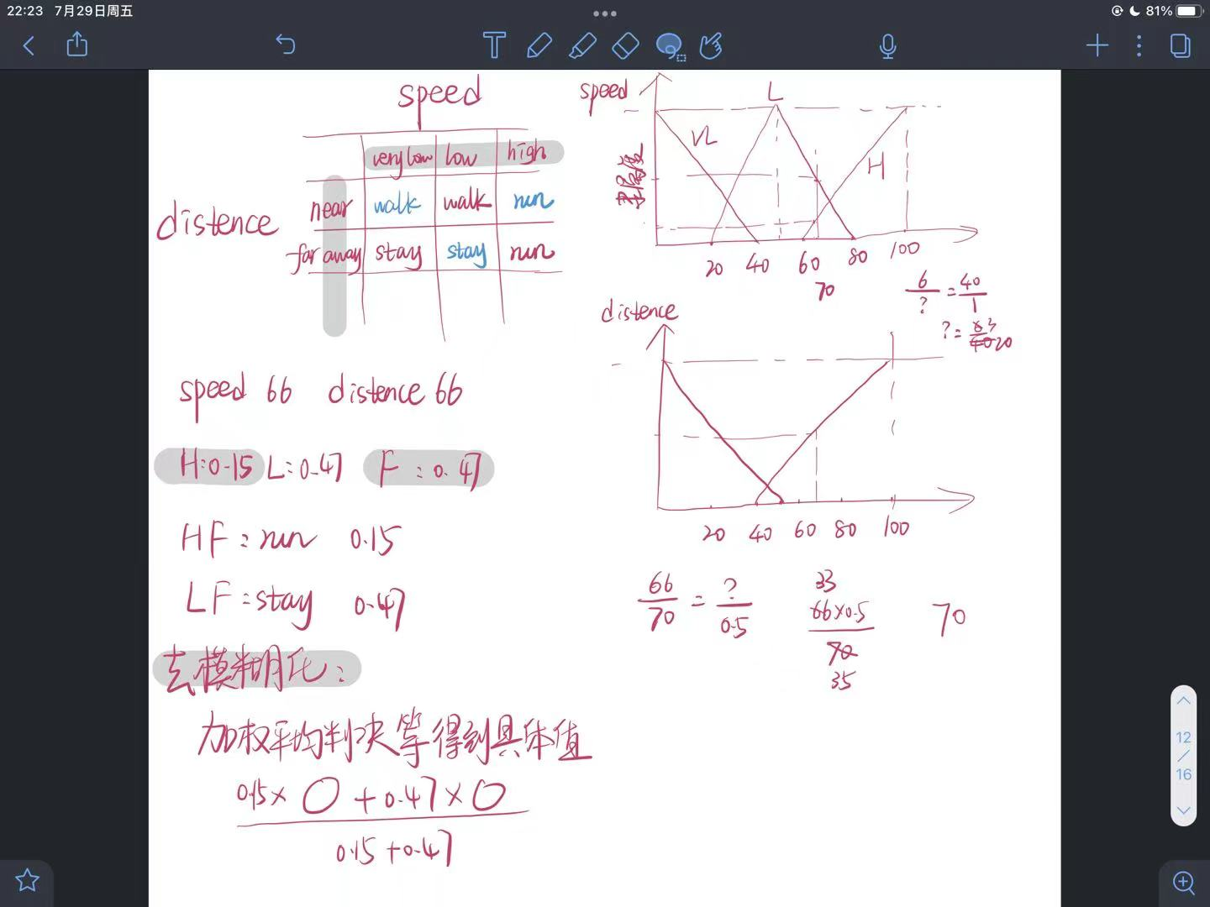
Fuzzy Selector
Notes:
把X1,X2模糊化，得到隶属度，
除了加权平均判决法，还有最大值均值法、中心法、最大值平均法

Slide 14
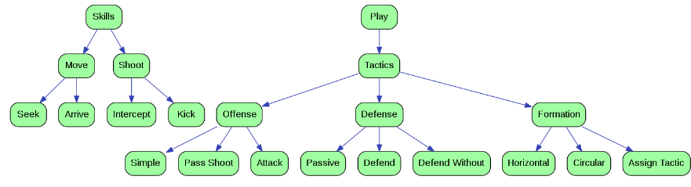
Hierarchical Behaviours
Skills - control a single robot.
Move - moves robots around the field
Shoot - shoots towards a target location
Pass - uses two robots to execute a pass
Intercept ball - moves robot to a position to intercept the ball
Defend Goal - goal keeper behavior

Slide 15
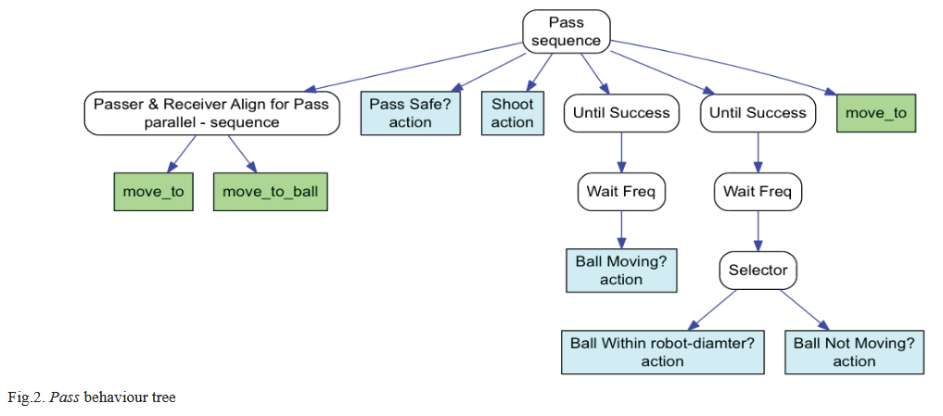
Hierarchical Behaviours
Skills - control a single robot.
Tactics - control a single or many robots (more complex behavior )

Slide 16
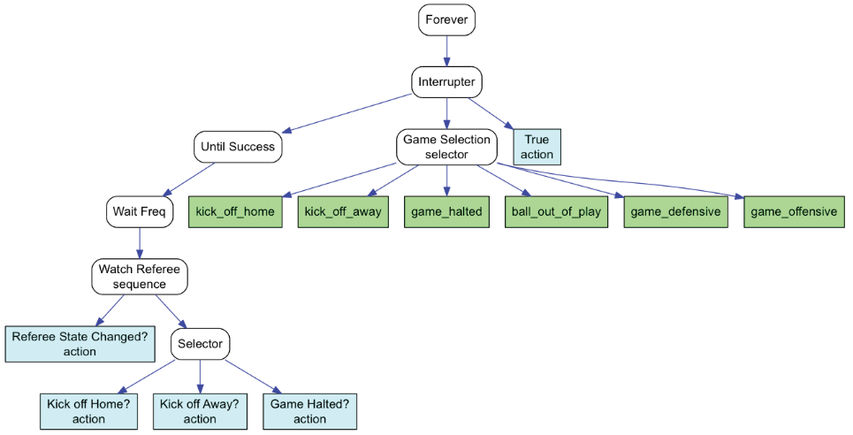
Hierarchical Behaviors
Skills - control a single robot.
Tactics - control a single or many robots (more complex behavior )
Plays - control the whole team of robots.
Offensive Game - attacking the opponent team
Defensive Game - defending against opponent team
Formations - moves the robots to various hard coded locations on the field
Game Selection - Selects main play to execute depending on the game state

Slide 17
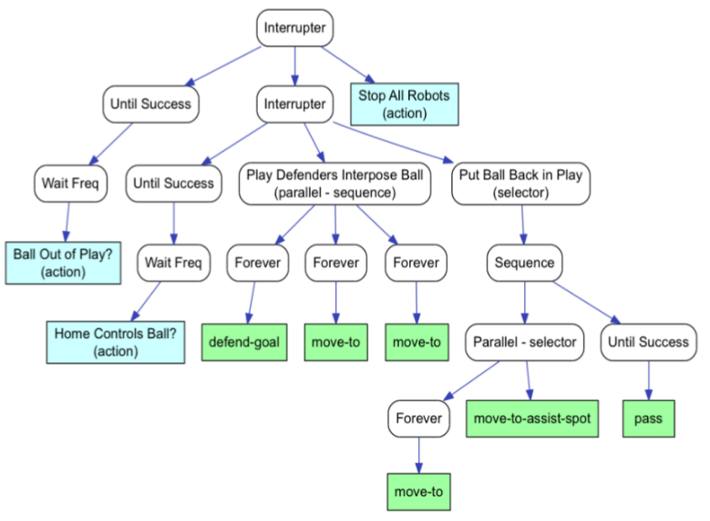
Hierarchical Behaviors
Skills - control a single robot.
Tactics - control a single or many robots (more complex behavior )
Plays - control the whole team of robots.

Slide 18
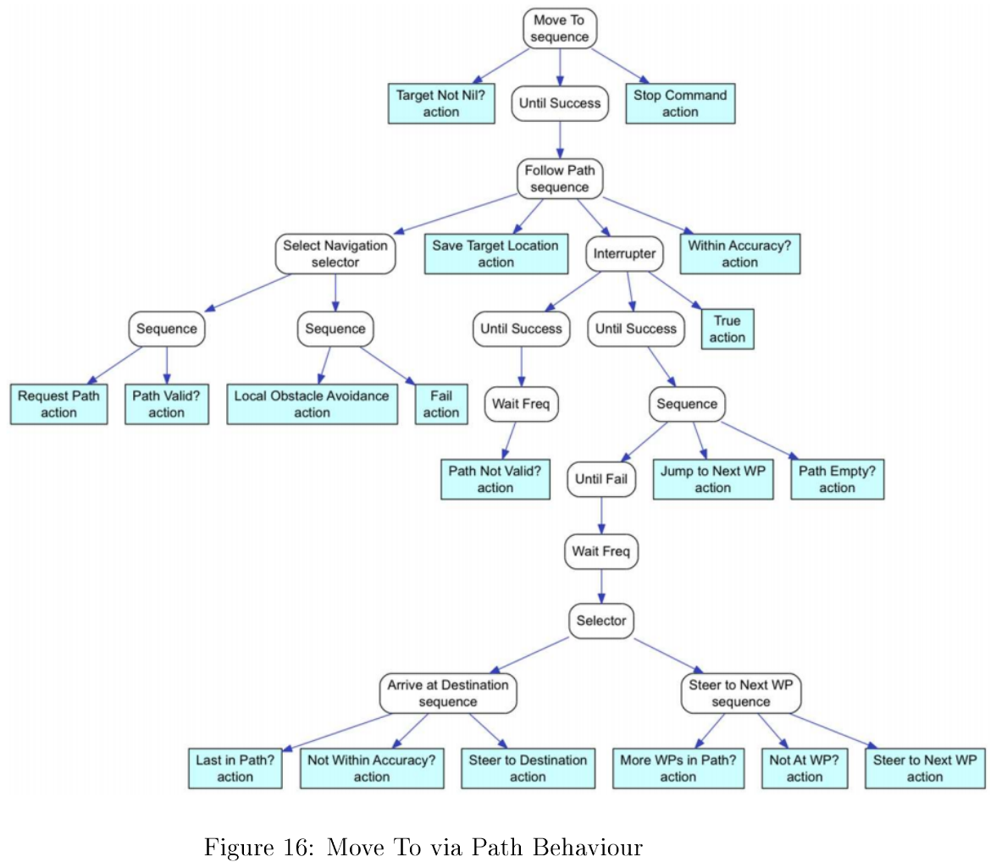
Hierarchical Behaviors

Slide 19
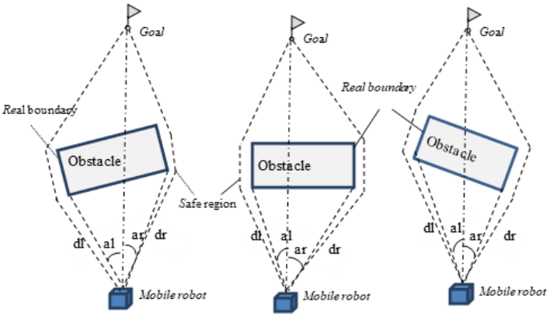
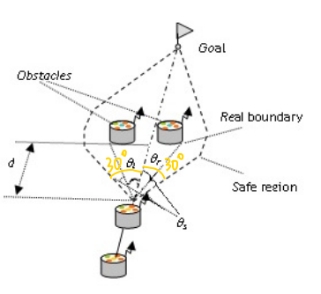
Fuzzy obstacle avoidance
Avoid obstacles
Reach target point

Slide 20
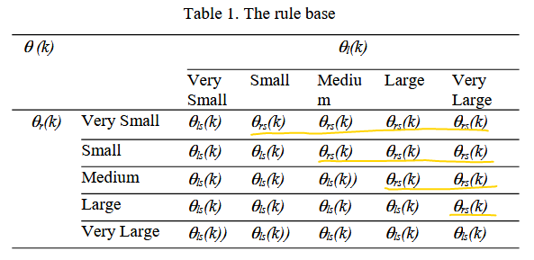
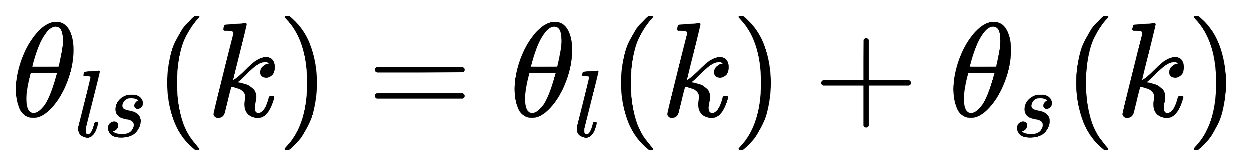
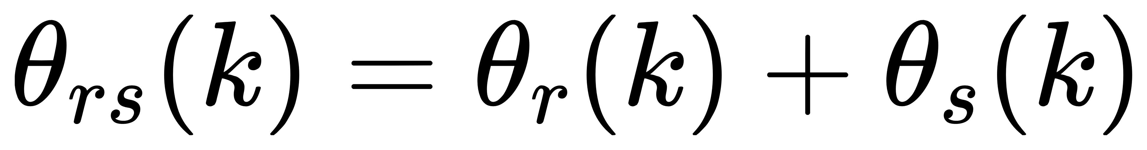
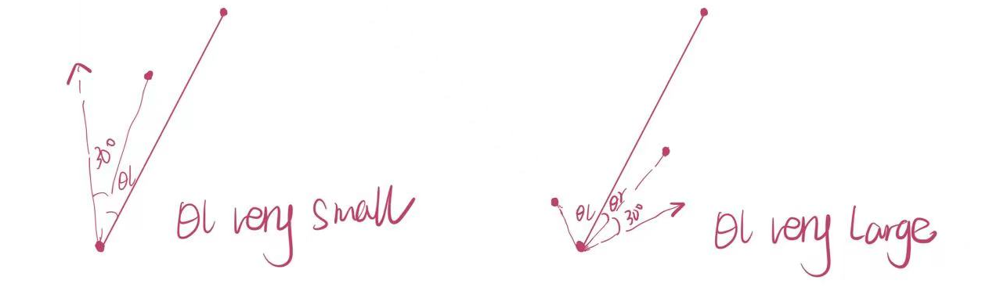
Fuzzy obstacle avoidance

Slide 21
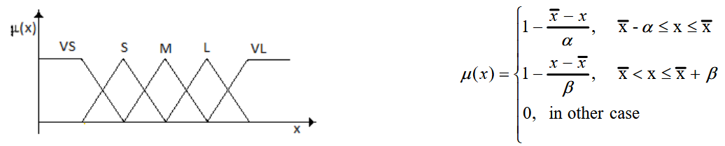
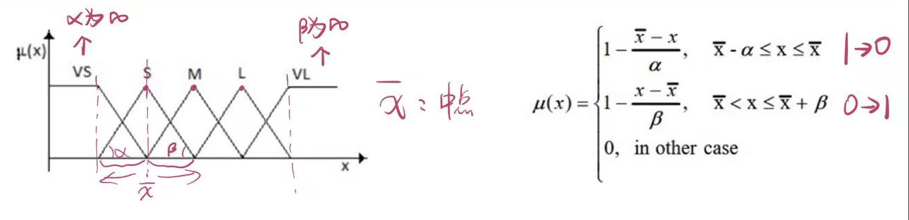
Fuzzy obstacle avoidance
Notes:
语言变数

Slide 22
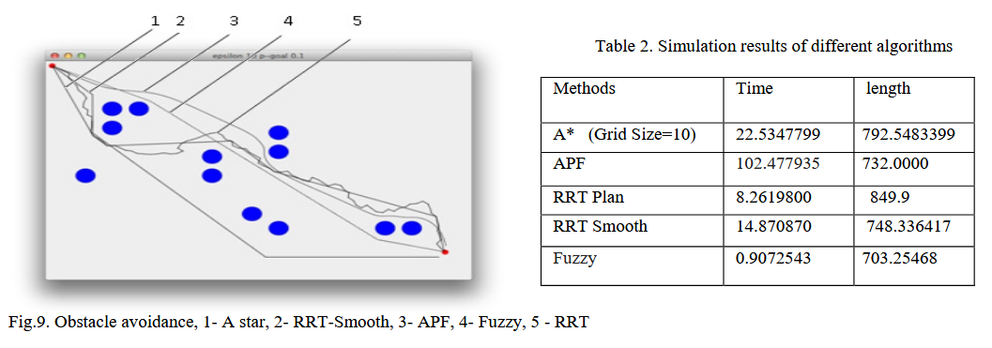
Experiments
Simulation

Slide 23
Experiments
Real life implementation
NEUIslanders
16:9 → 17:6 → 18:7 → 19:6 → 21:4
The average time for making a decision was 0.02 ms.
In the case of the simple tree the running time was 0.003 ms.
Run time for the more complicated BT having many levels of sequence and selection nodes was 0.2 ms.

Slide 24
Thanks
Notes:
2016年第十二届模糊系统与软计算应用国际会议
2013年第九届亚洲控制大会(Asian Control Conference ASCC)

